Slide 1
OSI Transport Layer

Slide 2
Objectives
Explain the role of Transport Layer protocols and services in supporting communications across data networks
Analyze the application and operation of TCP mechanisms that support reliability
Analyze the application and operation of TCP mechanisms that support reassembly and manage data loss.
Analyze the operation of UDP to support communicate between two processes on end devices

Slide 3
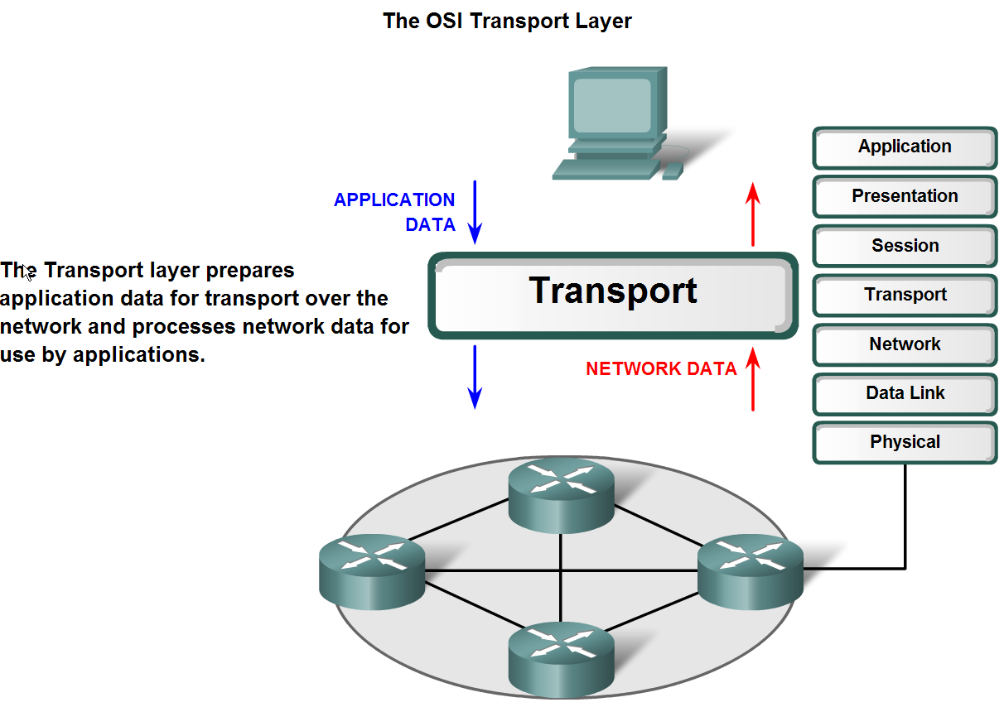
Transport Layer Role and Services

Slide 4
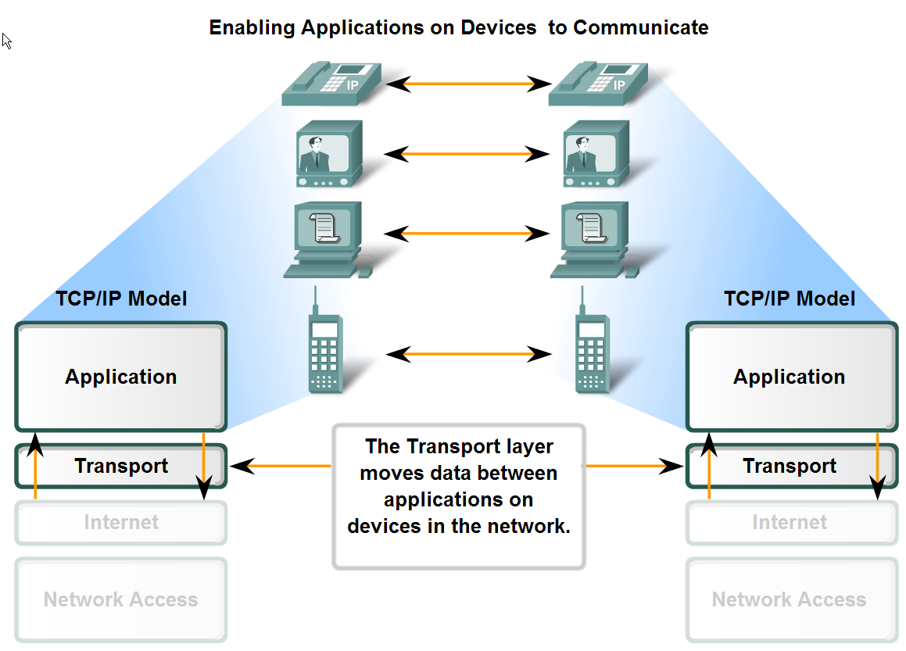
Transport Layer Role and Services

Slide 5
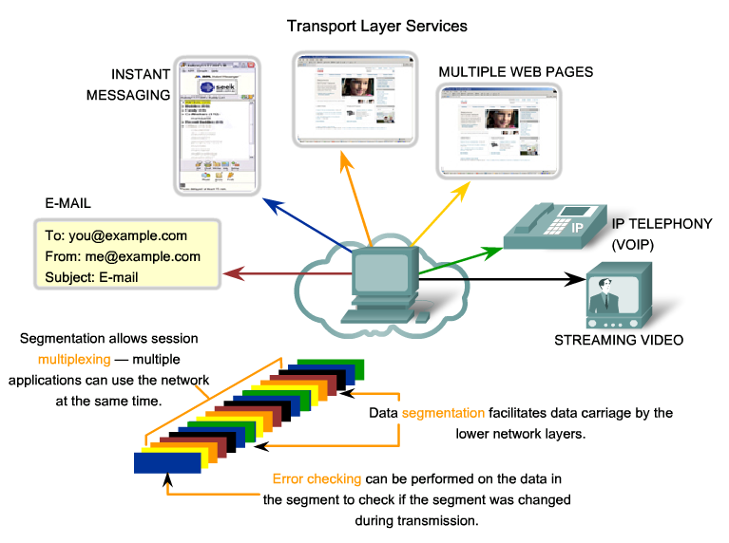
Transport Layer Role and Services

Slide 6
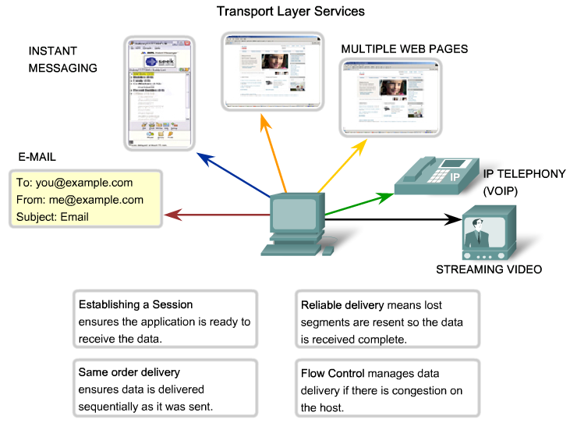
Transport Layer Role and Services

Slide 7
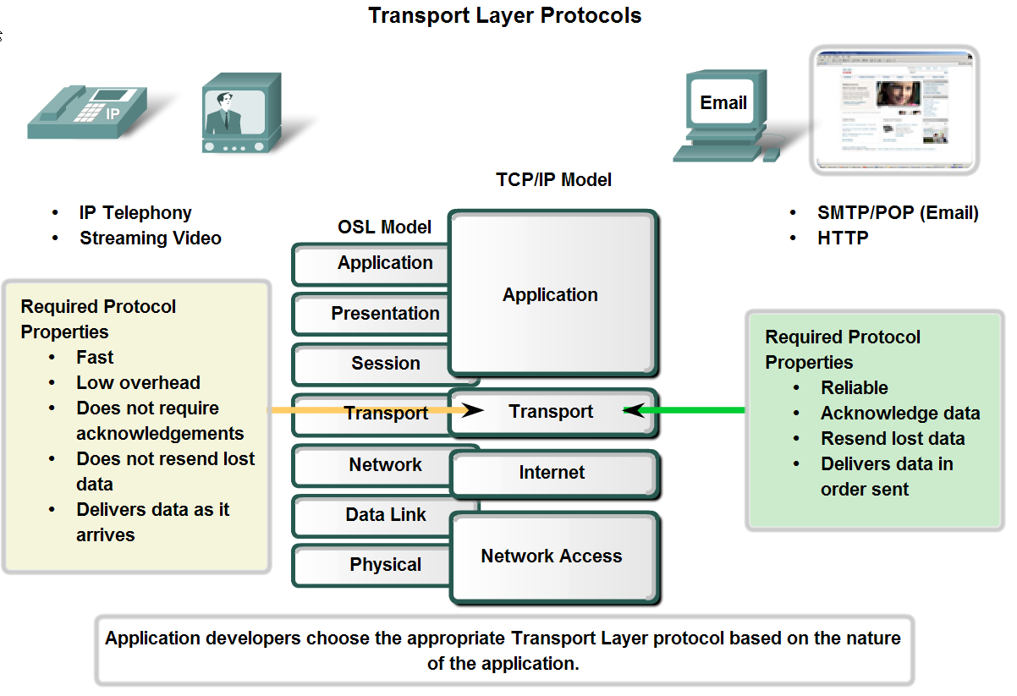
Transport Layer Role and Services

Slide 8
Transport Layer Functions
Transport Layer is responsible for the following
  segmentation of data
  error detection
  addressing of upper layer application using port numbers
  Multiplexing to allow multiple applications to be handled on the same connection
  The previous functions are supported by both the TCP & UDP
  for reliable data delivery (TCP):
    Establishment of connection (3-way handshake)
    Management of connection
      reliability (sequencing and acknowledgements)
      error correction
      flow control (Buffering, congestion avoidance, Ready/not ready,
      windowing)
    Termination of connection (4-way handshake)
Transport Layer protocols are
  TCP (Transmission Control Protocol)
  UDP (User Datagram Protocol)

Slide 9
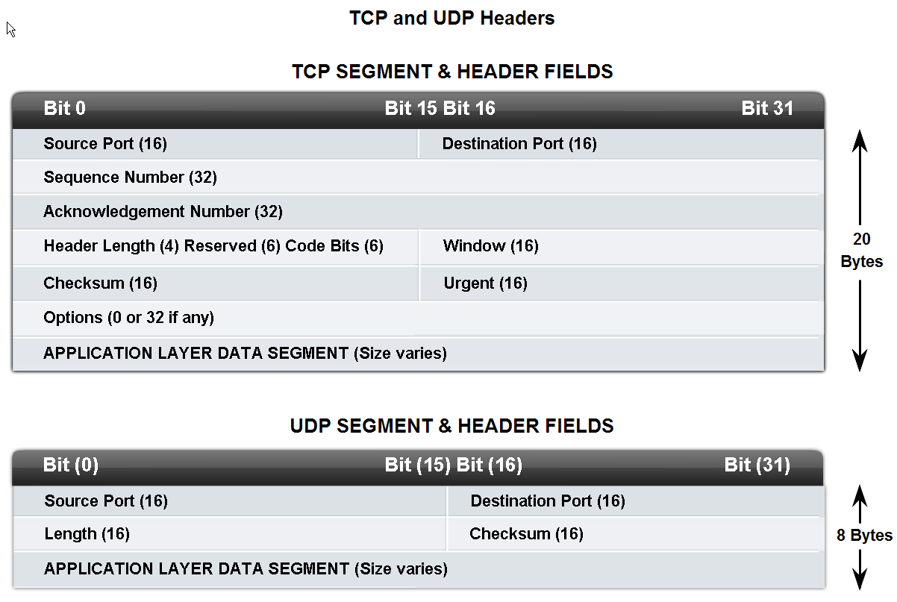
Transport Layer Role and Services

Slide 10
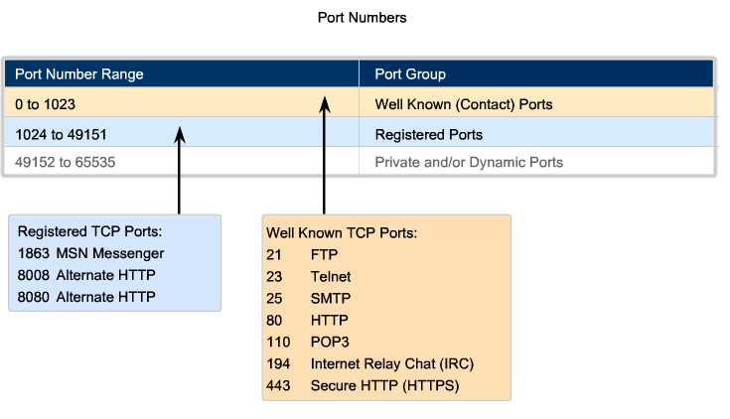
Port Numbers

Slide 11
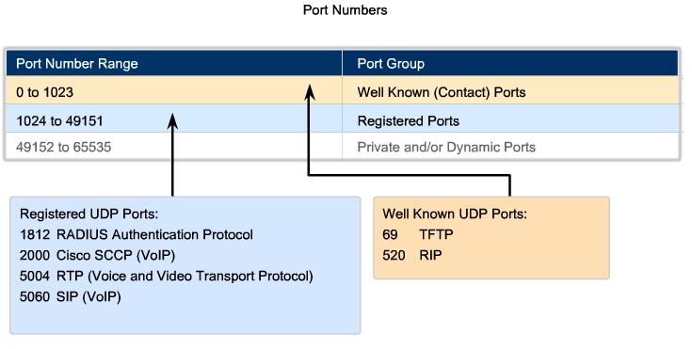
Port Numbers

Slide 12
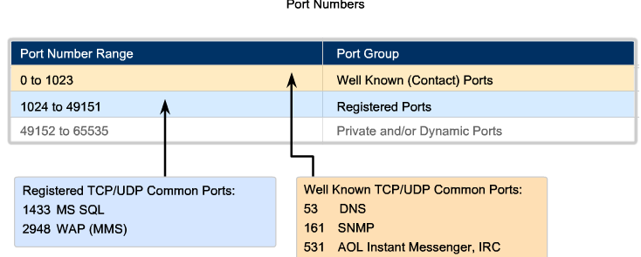
Port Numbers

Slide 13
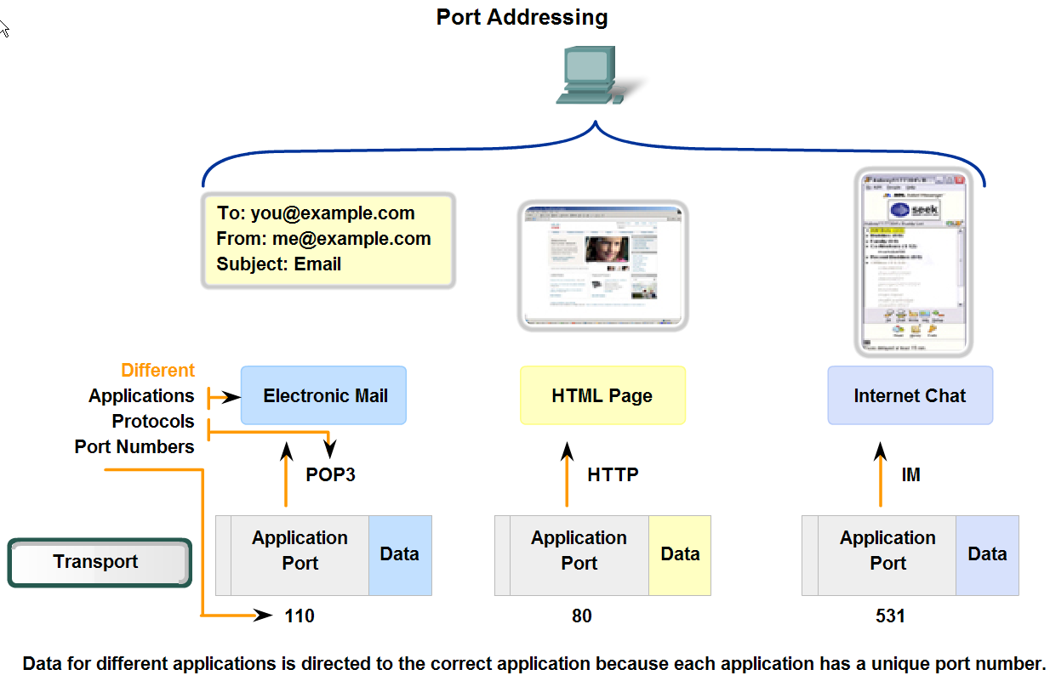
Port Numbers

Slide 14
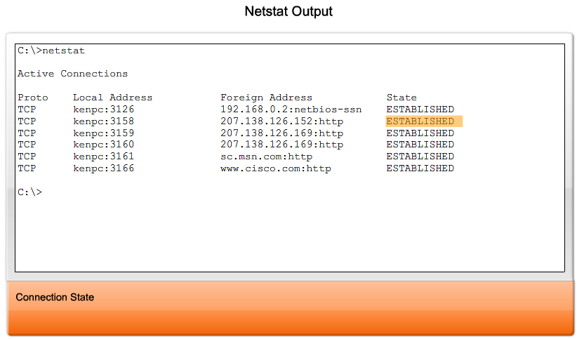
Port Numbers

Slide 15
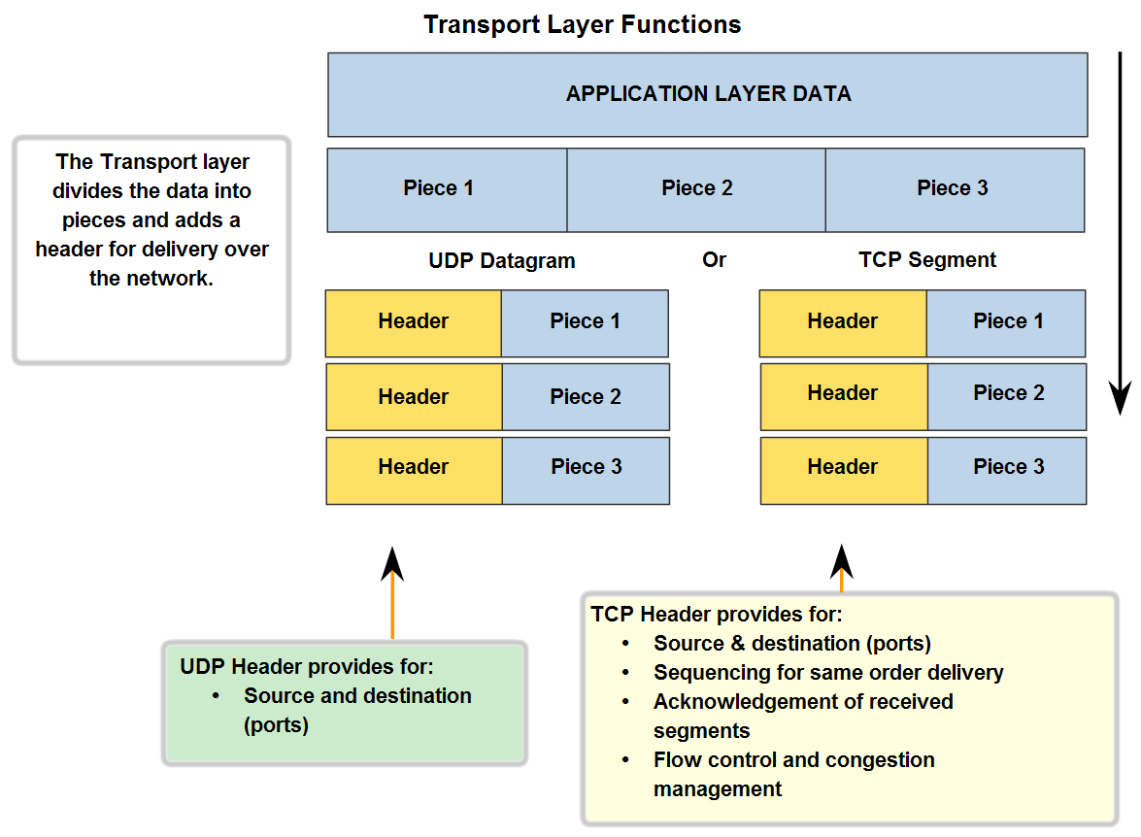
Transport Layer Functions

Slide 16
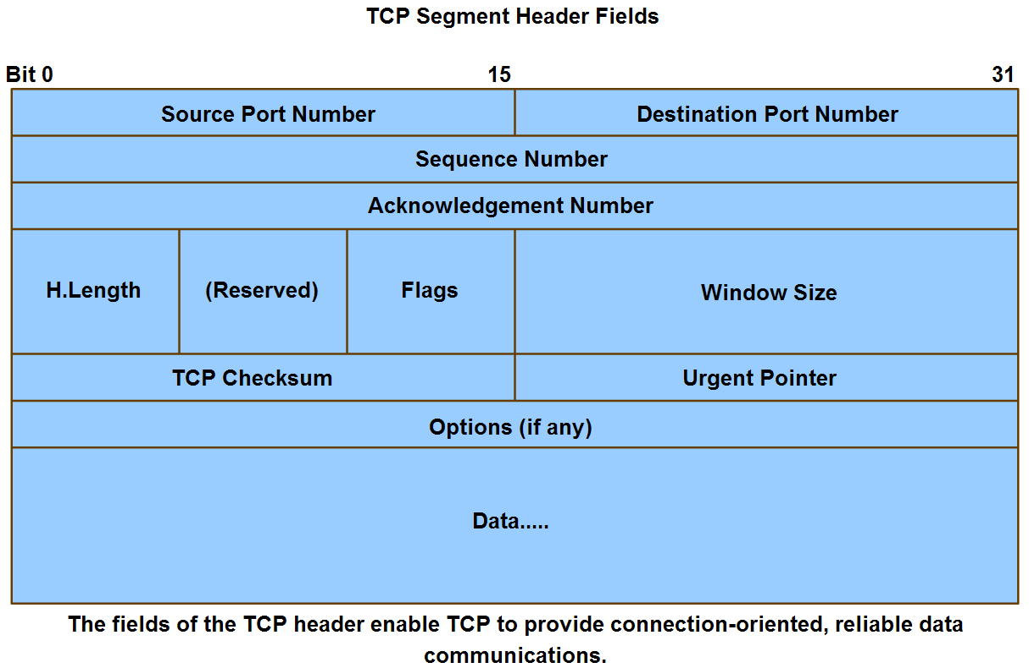
Application and Operation of TCP Mechanisms

Slide 17
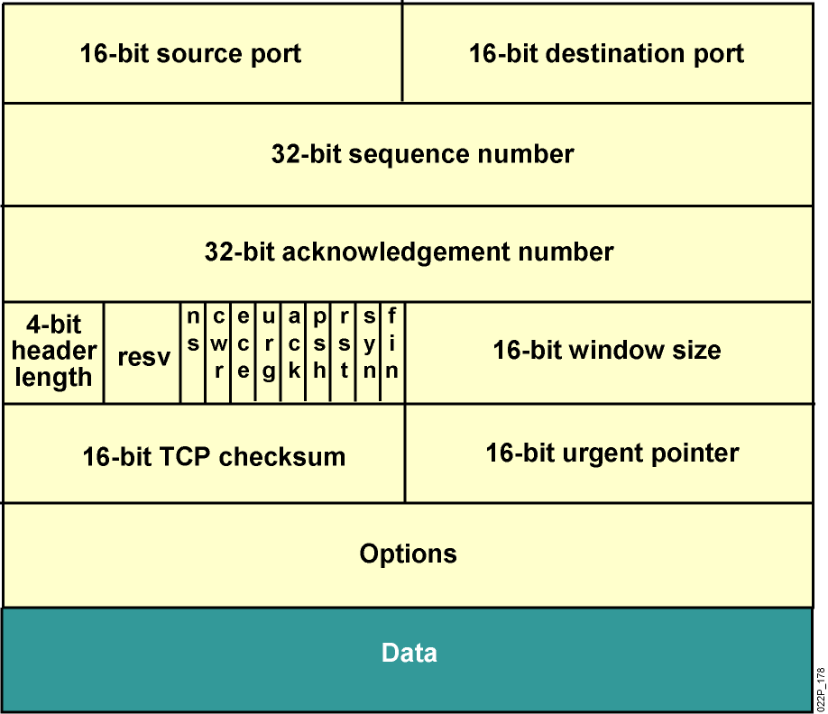
TCP Header
Notes:
Lesson Aim
<Enter lesson aim here.>

Slide 18
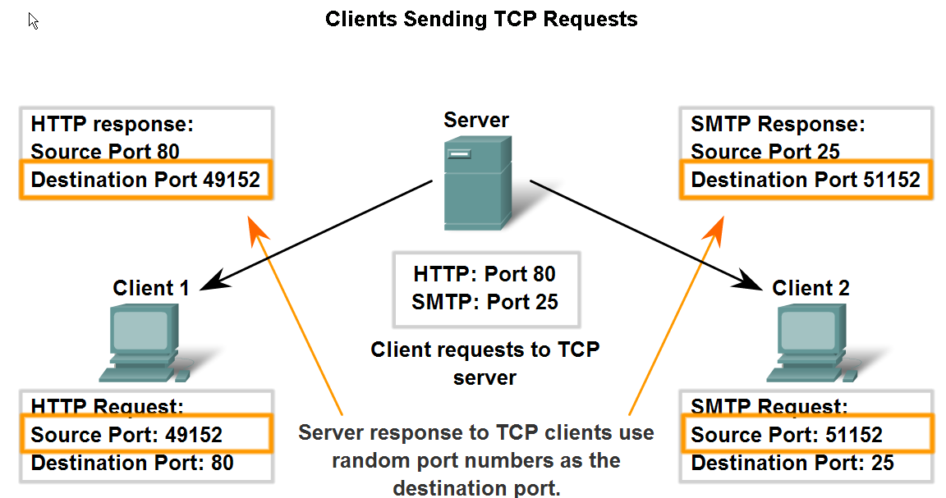
Application and Operation of TCP Mechanisms

Slide 19
TCP major characteristics
TCP is a connection-oriented transport protocol which means the sender should be sure of existing of the receiver before sending him the data and may notify him.
TCP is a reliable transport protocol which means the sender that every packet he sent is arrived and it is delivered correct otherwise he will retransmit it as a packet correction mechanism.

Slide 20
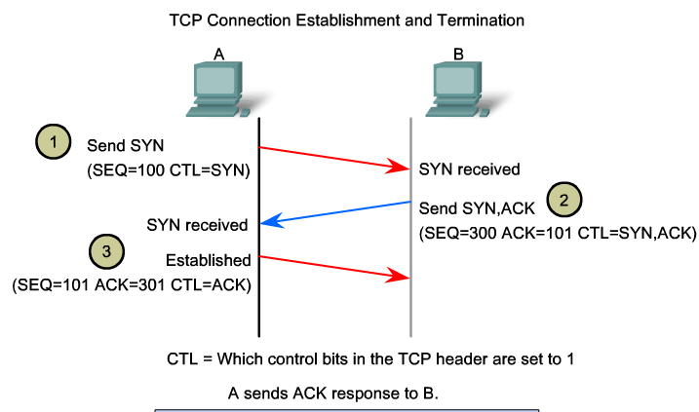
TCP Session Establishment

Slide 21
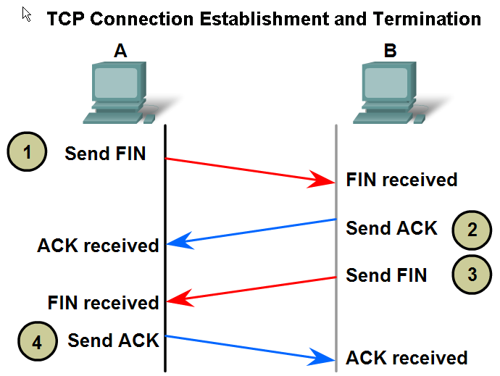
Application and Operation of TCP Mechanisms

Slide 22
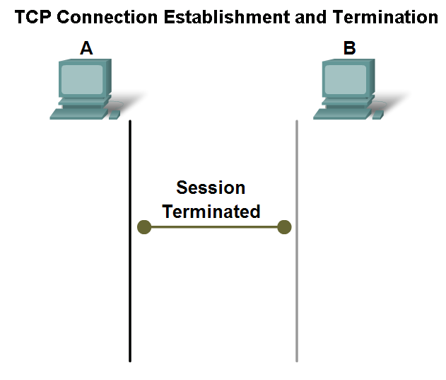
Application and Operation of TCP Mechanisms

Slide 23
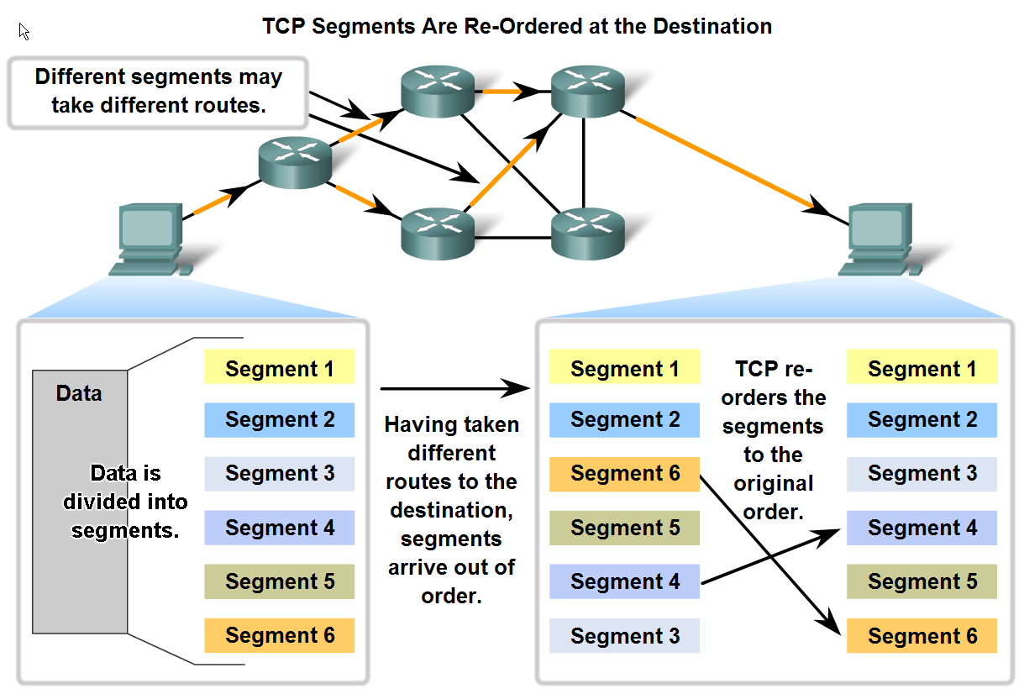
Managing TCP Sessions

Slide 24
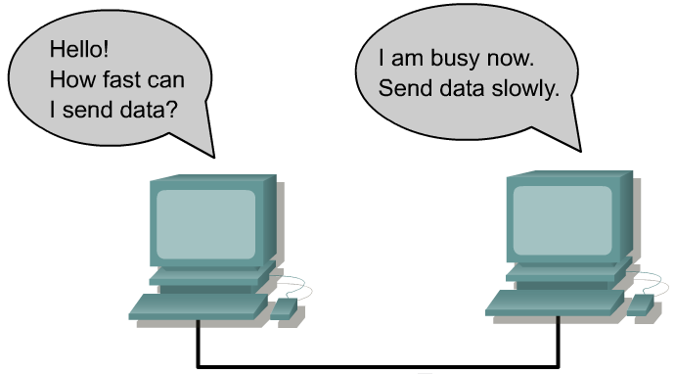
Flow Control
Flow control avoids the problem of a transmitting host overflowing the buffers in the receiving host.

Slide 25
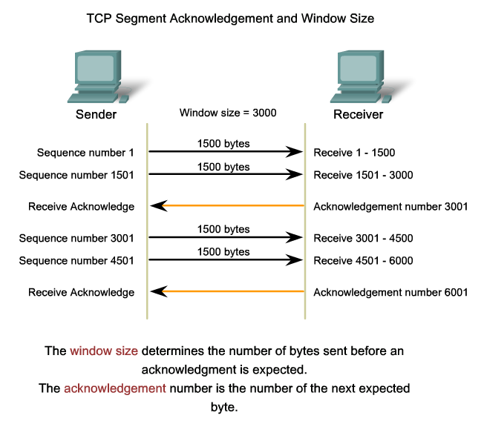
Managing TCP Sessions

Slide 26
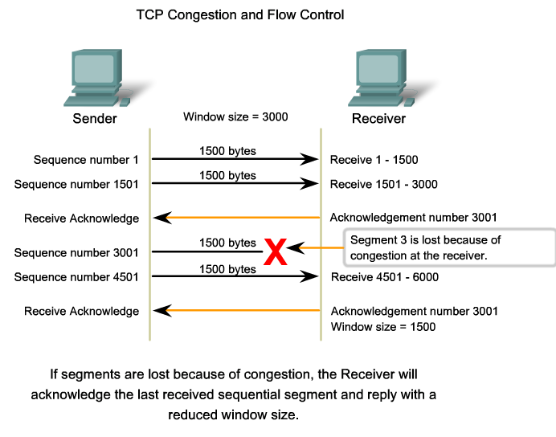
Managing TCP Sessions

Slide 27
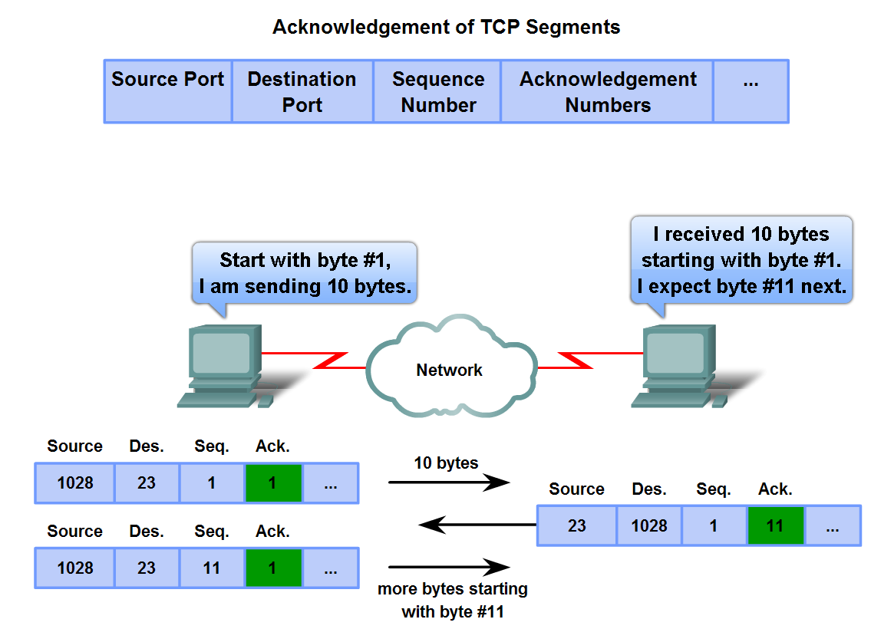
Managing TCP Sessions

Slide 28
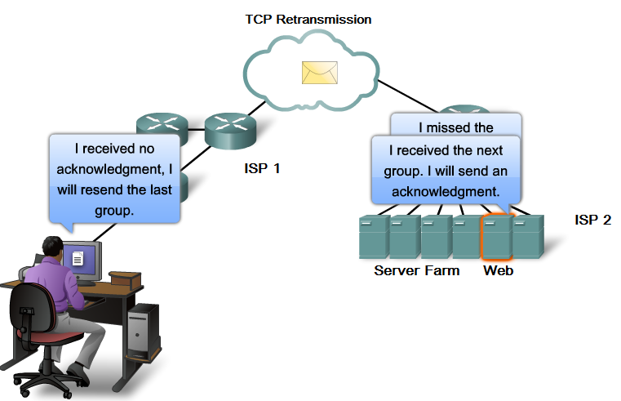
Managing TCP Sessions

Slide 29
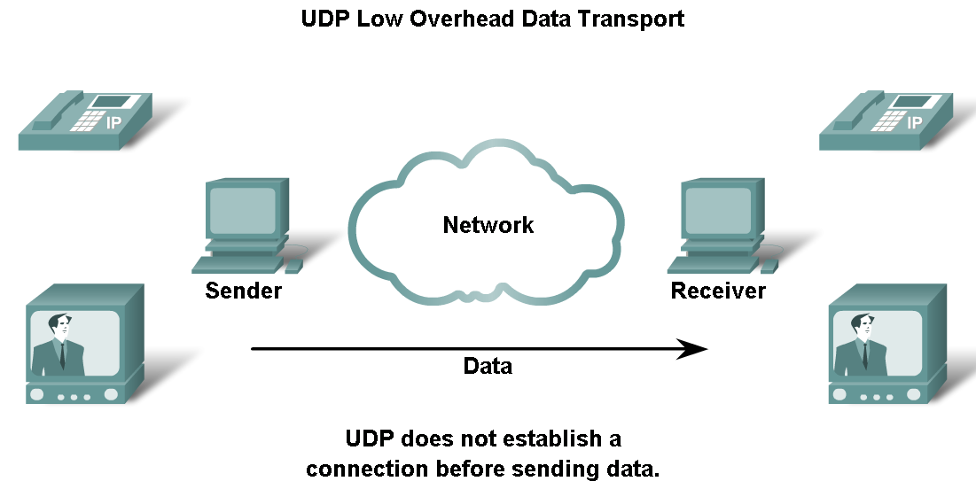
UDP Protocol

Slide 30
UDP Characteristics
Operates at transport layer of OSI and TCP/IP models
Provides applications with access to the network layer without the overhead of reliability mechanisms ( speedy )
Connectionless protocol
Limited error checking
Best-effort delivery
No data recovery features

Slide 31
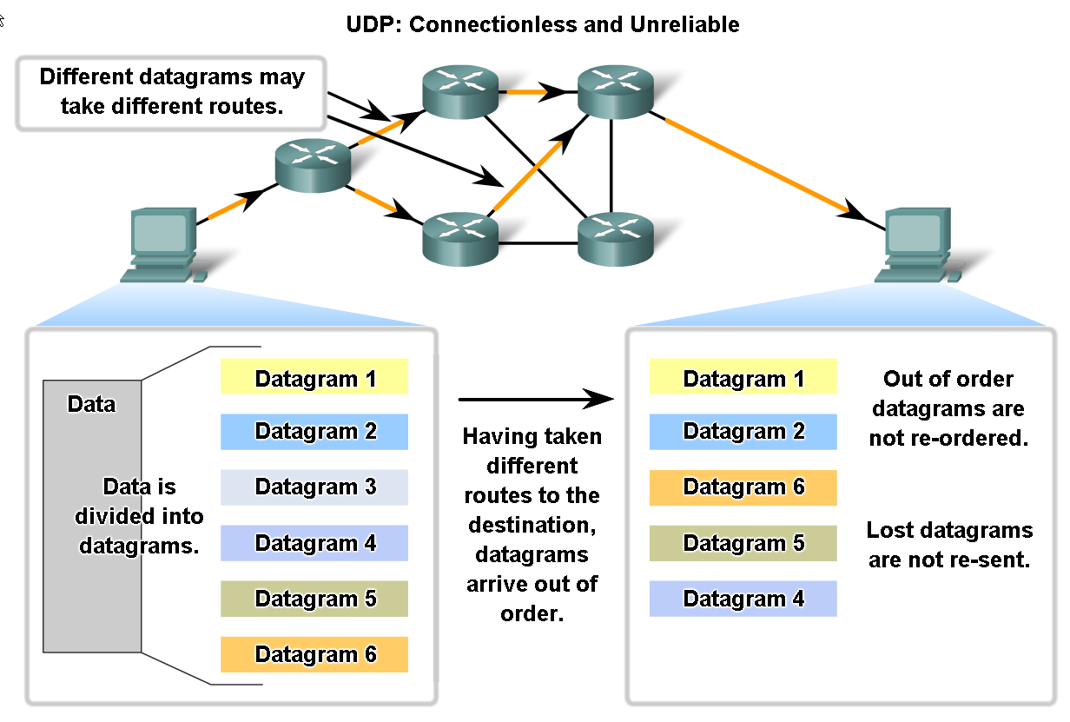
UDP Protocol

Slide 32
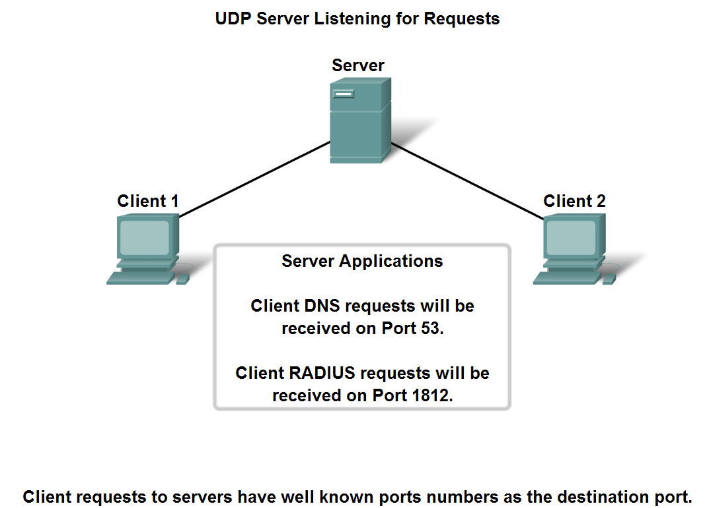
UDP Protocol

Slide 33
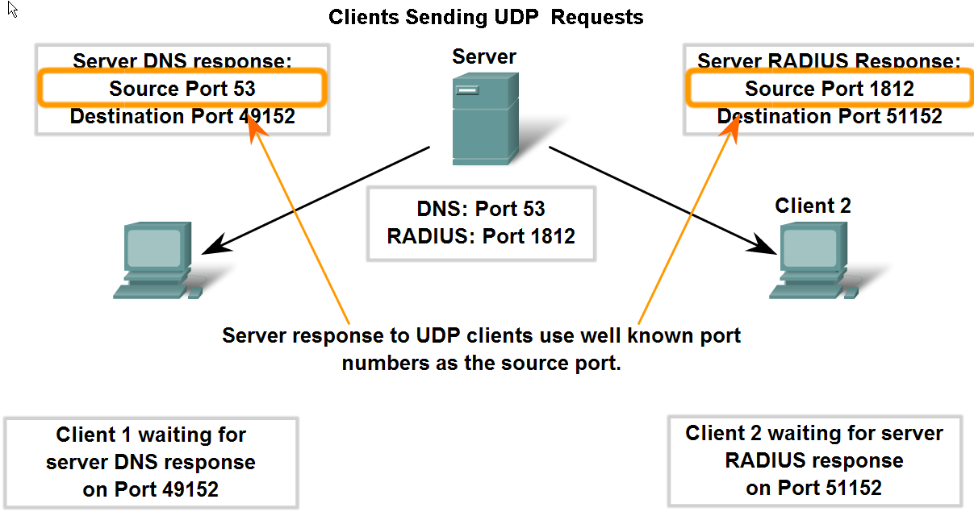
UDP Protocol

Slide 34
Summary
- TCP :
- Transmission Control Protocol
- Connection oriented (Reciever is waiting the traffic)
- Reliable service (traffic overhead is used to insure data delivery)
- UDP :
- User Datagram Protocol
- Connectionless
- Unreliable service

